Slide 1
Explorathon 2016
Exploring Computer Science
Through Game Development

Slide 2



Women in Computer Science

Slide 3
Careers in Computer Science
Software Engineer
Web Application Developer
Mobile Application Developer
Video Game Developer
...and so much more!
Today we will show you what its like to develop a video game and write real code!

Slide 4
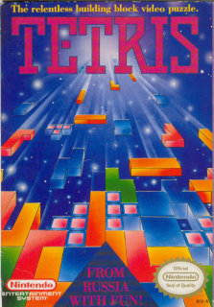
Our Inspiration
The game we will create today is based on the classic video game Tetris. We have changed the images, but the heart of Tetris remains.
We have also supplied a finished version of our game.

Slide 5
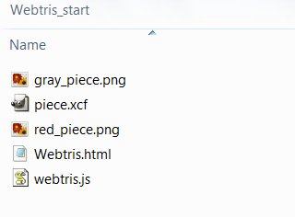
Open the starter project
Open up the file browser
Find the Webtris_start folder in the external hard drive
The initial setup of the project comes with:
  Files for the game piece graphics
  An HTML file that draws our pieces, calls our code, and displays our game
  A JavaScript file that does all the work!

Slide 6
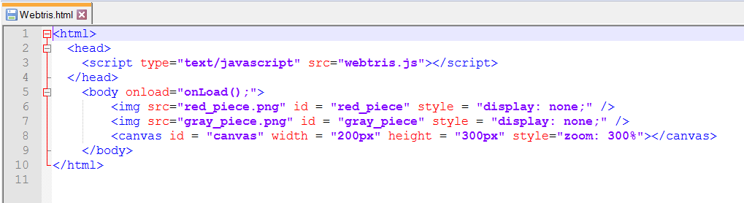
Our Simple HTML File
In the HTML file, the images are loaded in the body of the page, but they are hidden with “display:none”
The canvas element is what we draw our game on
We can also see that something called “onLoad()” is called on the body during the “onload” event.

Slide 7
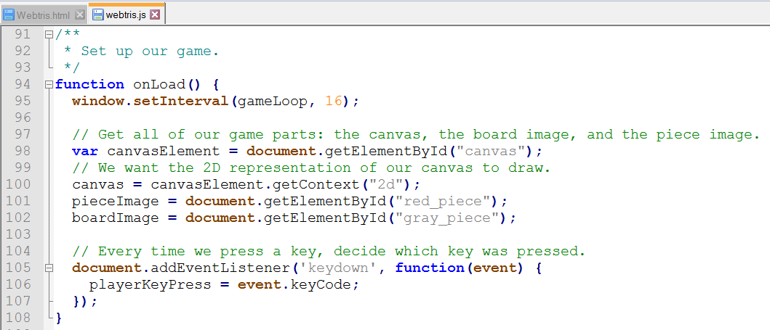
Our onLoad() Event
Open the
JavaScript file
If we scroll all the
way to the
bottom, we can
see our onLoad()
function
It takes the canvas from the HTML file, and gets ready for us to draw with it
We tell our code to listen for key presses, and record it's unique code
Then we draw our game board

Slide 8
Let's Draw Something
Find the function at the top of the file called drawGame()
The first thing we are going to do is make a black background for our game
It's going to be in the top left corner of our screen, which is (0, 0)
It's going to be 200px by 300px because that's the size of our canvas in the HTML file
After we have the code below, open the HTML file in the browser
function drawGame() {
canvas.fillStyle = "black";
canvas.fillRect(0, 0, 200, 300);
}

Slide 9
Let's Draw an Image
Underneath our black background code, we're going to draw the pieceImage (a red square)
Again, we want to draw this at the top left corner at (0, 0)
After we write this one line of code, we can refresh our HTML file in the browser
canvas.drawImage(pieceImage, 0, 0);

Slide 10
Drawing a Piece
We are going to change the line we just wrote to draw a whole Webtris piece instead of just one square
We use an “array” to define the shape of our game piece
It looks a lot like a mathematical matrix!

Slide 11
Arrays – a Quick Lesson
Our JavaScript file is filled with arrays because they're easy to use to store our game board and the piece shapes
When we want to step through our array, we use something called a “for loop”
We grab the first row, and the first column
Our next step is the next column on the same row, until we run out of columns
Then we move to the next row
[0, 1, 0],
[0, 1, 0],
[0, 1, 1]

Slide 12
Writing Our For Loop
for (var x = 0; x < piece[0].length; x ++) {
for (var y = 0; y < piece.length; y ++) {
if (piece[y][x] == 1) {
canvas.drawImage(pieceImage, x * 8, y * 8);
}
}
}
We need two “for loops” because we need to keep track of the row and column
When we find a 1 in our piece array, we can draw our single square
We multiply it by 8 because that's the size of the image – an 8px by 8px square
After we have our code written, let's check it in the browser!

Slide 13
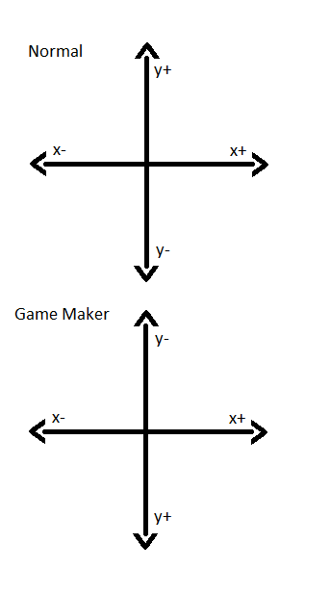
Coordinates – A Quick Review
We can move our piece around on the screen according to x and y positions
So, when we want our piece to go left, our playerXIndex decreases
Because the top left corner of our screen is (0, 0), when we press down we want to increase our playerYIndex
We don't want our pieces to move up, so we won't write any code for that direction

Slide 14
Make Things Move
Go to the handleInput() function above the drawGame() function
We are going to determine which key is pressed, then
change our piece direction based on that
Our unique codes for the key presses are already saved for us
In order to see where our piece is, we need to update drawGame()
if (playerKeyPress == KEY_PRESS_DOWN) {
playerYIndex = playerYIndex + 1;
}

Slide 15
Updating drawGame()
Back on the drawGame() function, we need to change the line that draws our image
We need to add our updated position to the x and y coordinates
We need to multiply the entire x/y position by 8 because of the size of our image
After we've updated to the code below, it's time to test!
canvas.drawImage(pieceImage,
(x + playerXIndex) * 8,
(y + playerYIndex) * 8);

Slide 16
Other Directions
We can copy our “if statement” from earlier
If the user presses the right key, our playerXIndex is going to increase
If the player presses the left key, our playerXIndex is going to decrease
After we have the code below, we can test it in our browser
if (playerKeyPress == KEY_PRESS_DOWN) {
playerYIndex = playerYIndex + 1;
}
if (playerKeyPress == KEY_PRESS_RIGHT) {
playerXIndex = playerXIndex + 1;
}
if (playerKeyPress == KEY_PRESS_LEFT) {
playerXIndex = playerXIndex - 1;
}

Slide 17
Drawing Our Walls
We are going back to our drawGame() function to draw our board
We do this by moving through our “board” matrix and drawing a boardImage where we find a 2
for (var x = 0; x < board[0].length; x ++) {
for (var y = 0; y < board.length; y ++) {
var value = board[y][x];
if (value == 2) {
canvas.drawImage(boardImage, x * 8, y * 8);
}
}
}

Slide 18
Inside the Wall
Our piece is going through the walls!
To fix that, we have to write a new function to check for a “collision” to see if our wall is there
function checkCollision(playerXPosition, playerYPosition, playerRotation) {
for (var x = 0; x < piece[0].length; x ++) {
for (var y = 0; y < piece.length; y ++) {
var value = piece[y][x];
if (value > 0 && board[playerYPosition + y][playerXPosition + x] > 0) {
return true;
}
}
}
return false;
}

Slide 19
Handle Collision
We need to check for a collision inside of our handleInput() function using our new checkCollision() function
If there is not a collision, then we can change our playerXIndex or playerYIndex
if (playerKeyPress == KEY_PRESS_DOWN) {
if (!checkCollision(playerXIndex, playerYIndex + 1)) {
playerYIndex = playerYIndex + 1;
}
}
if (playerKeyPress == KEY_PRESS_RIGHT) {
if (!checkCollision(playerXIndex + 1, playerYIndex)) {
playerXIndex = playerXIndex + 1;
}
}
if (playerKeyPress == KEY_PRESS_LEFT) {
if (!checkCollision(playerXIndex - 1, playerYIndex)) {
playerXIndex = playerXIndex - 1;
}
}

Slide 20
Steps to Finish Your Game
Create the other piece shapes
Make the pieces appear randomly
Each time a line is formed, destroy it! After 10 lines have been removed, speed up the game
Display each piece with a count of how many were generated
Create a score board and keep track of the score
Make the pieces fall smoothly
Please keep an eye on https://github.com/originalgrego/Webtris for additions to this tutorial

Slide 21
Thank you!
Included on your flash drive are the following programs
  Game Maker – A free to evaluate game engine (plus last year's slides!)
  Gimp – A free and open source image editor
  Audacity – A free sound editing program
  Reaper – A digital audio workstation program providing convenient licensing
  Blender – A free and open source 3d modeling tool
  Tiled – A free and open source Tile Map editing tool, used for creating complex levels
Please visit https://github.com/originalgrego/Webtris for future updates to this project or to help in its development. Webtris is a GPL'd open source project that anyone can contribute to!
We hope you enjoyed Webtris!

